Slide 1
SI 671 Discussion 2
Itemset

Slide 2

Market Basket Analysis
Why are breads always conveniently placed beside butter in groceries?
[1] Data Mining: Market Basket Analysis with Apriori Algorithm https://towardsdatascience.com/data-mining-market-basket-analysis-with-apriori-algorithm-970ff256a92c.

Slide 3
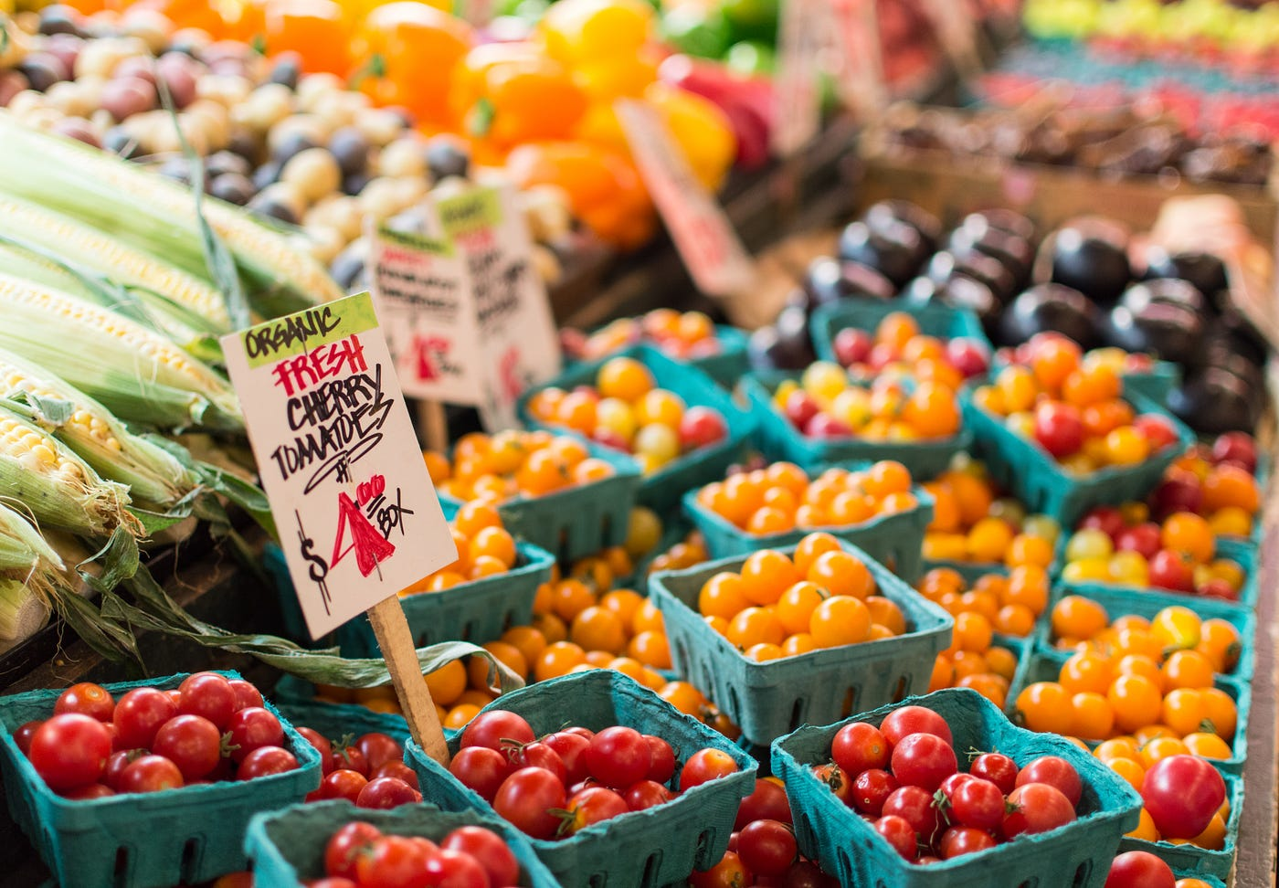
Market Basket Analysis
Market Basket Analysis is one of the key techniques used by large retailers to uncover associations between items.
Associated products are placed close to each other, so that buyers of one item would be prompted to buy the other.
Discounts can be applied to only one of the associated products.
Market Basket Analysis
[2] Groceries dataset. https://www.kaggle.com/datasets/heeraldedhia/groceries-dataset.

Slide 4
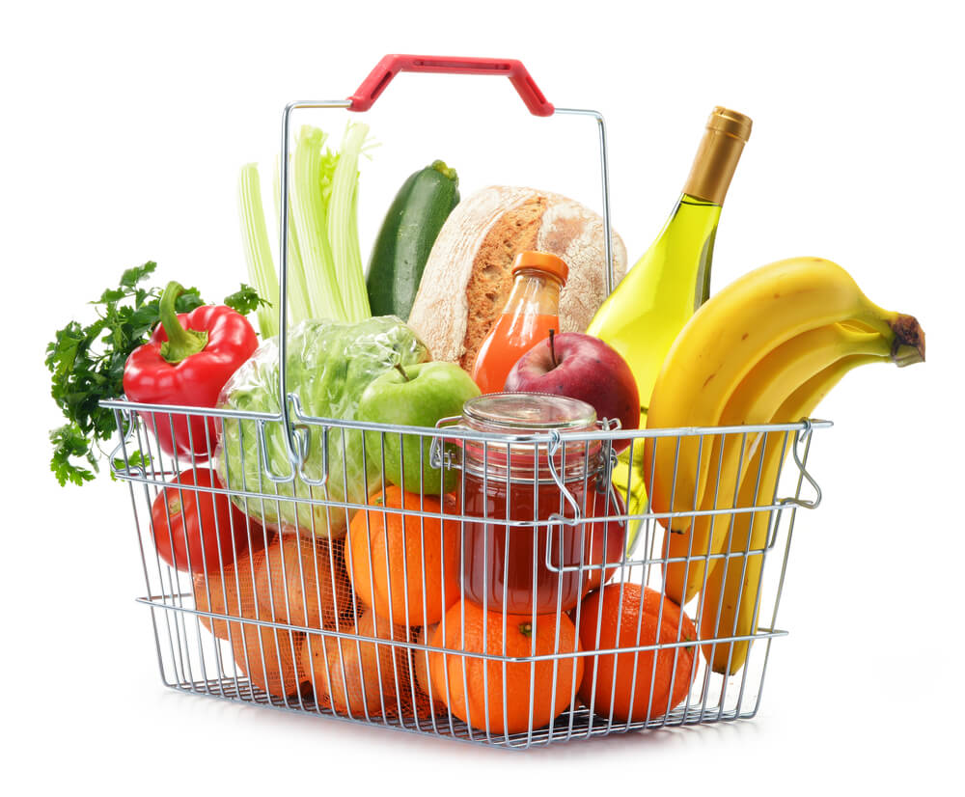
Data Type
Item1, item2, item3.....
Itemset
Item association: Apriori algorithm
Itemset similarity: Jaccard similarity
Representation: set, binary vector (later)
Market Basket
Notes:
What is the meaning of the summation of the binary vector?
What is the meaning of the dot product of two binary vector?

Slide 5
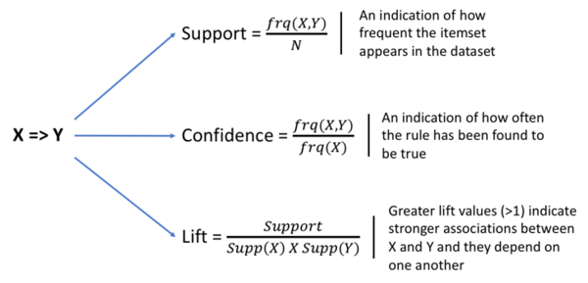
Concepts in Apriori Algorithm
Notes:
not all high confidence association rules are interesting!

Slide 6
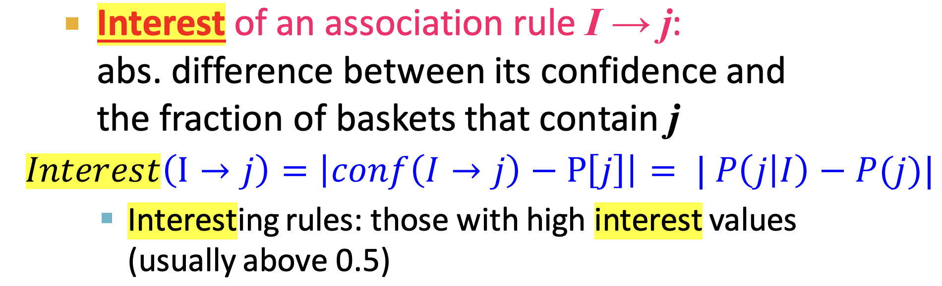
One Way to Calculate Interest
[3] Frequent Itemsets Mining. https://web.stanford.edu/class/cs246/slides/02-assocrules.pdf.

Slide 7
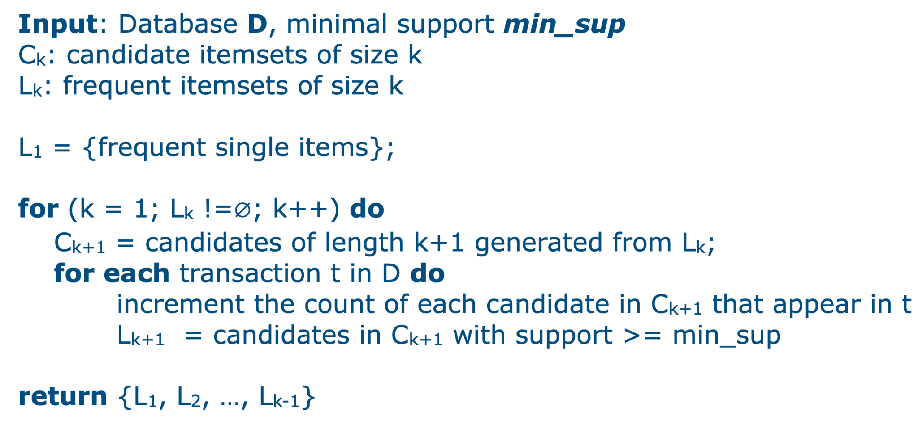

Slide 8
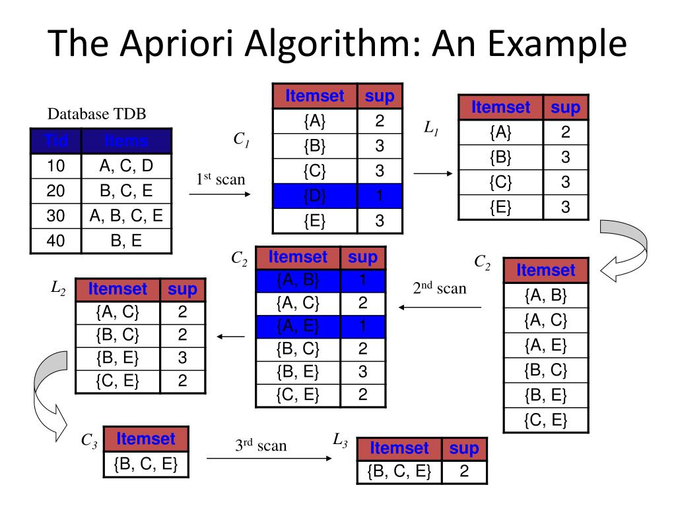
min_support: 0.5
By calculation, C₃ can also be [{A, B, C}, {A, C, E}, {B, C, E}].
Why only {B, C, E} here?
[3] Frequent Itemsets Mining. https://web.stanford.edu/class/cs246/slides/02-assocrules.pdf.
Notes:
How to generate? How to evaluate the subset is also a frequent itemset?

Slide 9
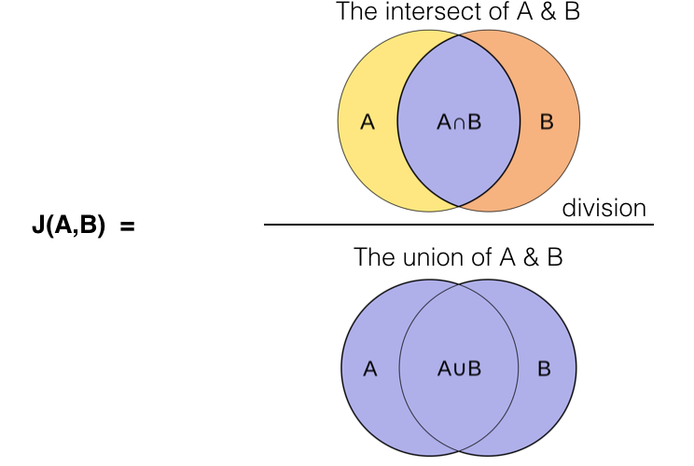
Jaccard Similarity

